Slide 1
Uber Drives
Michael F.
Mark P.
Harprit C.
CJ C.

Slide 2


Slide 3

Project Overview Dataset Analysis of Data
Database
Leaflet Map
Machine Learning
Tableau

Slide 4

Our Dataset

Slide 5
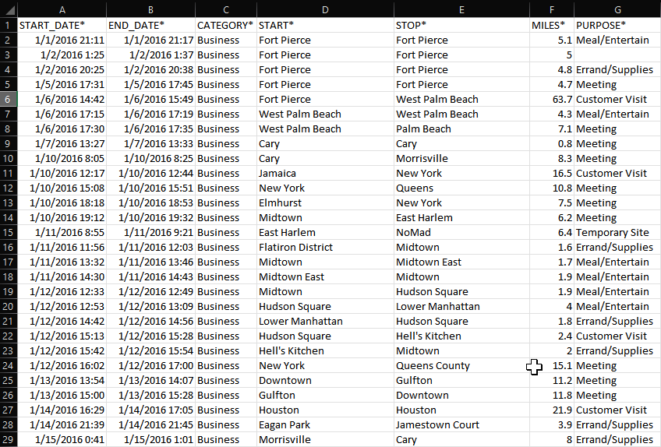
Original Dataset from Kaggle
https://www.kaggle.com/datasets/zusmani/uberdrives

Slide 6

When exploring our data, we initially split up into
our own Jupyter notebooks, then compared notes.

Slide 7
The original dataset had 7 rows: (1) START_DATE*
(2) END_DATE* (3) CATEGORY*
(4) START* (location - city) (5) STOP* (location - city)
(6) MILES* (7) PURPOSE*

Slide 8
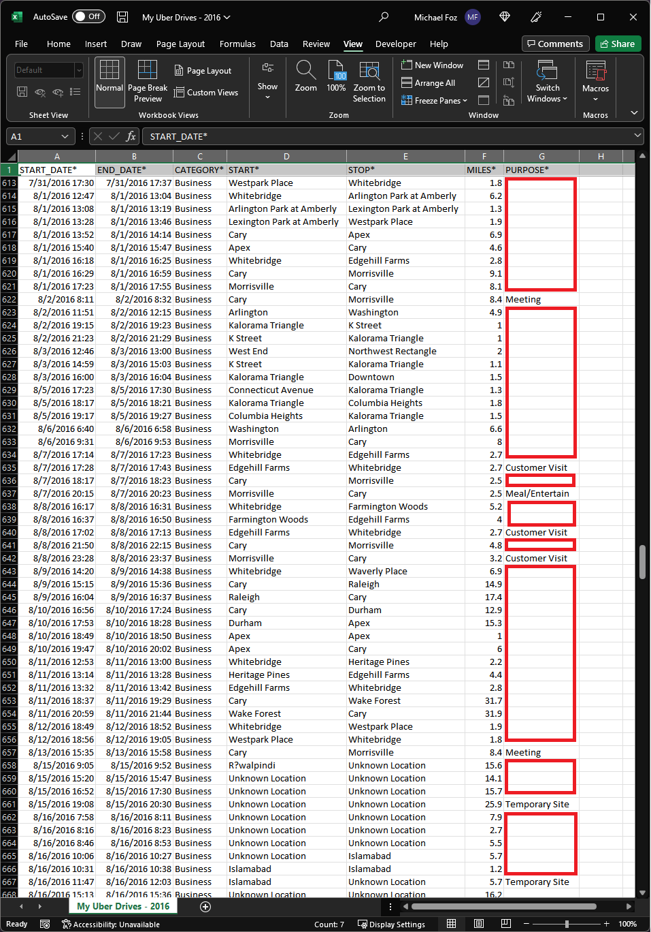
We encountered
a problem:
Missing values!
☠️

Slide 9
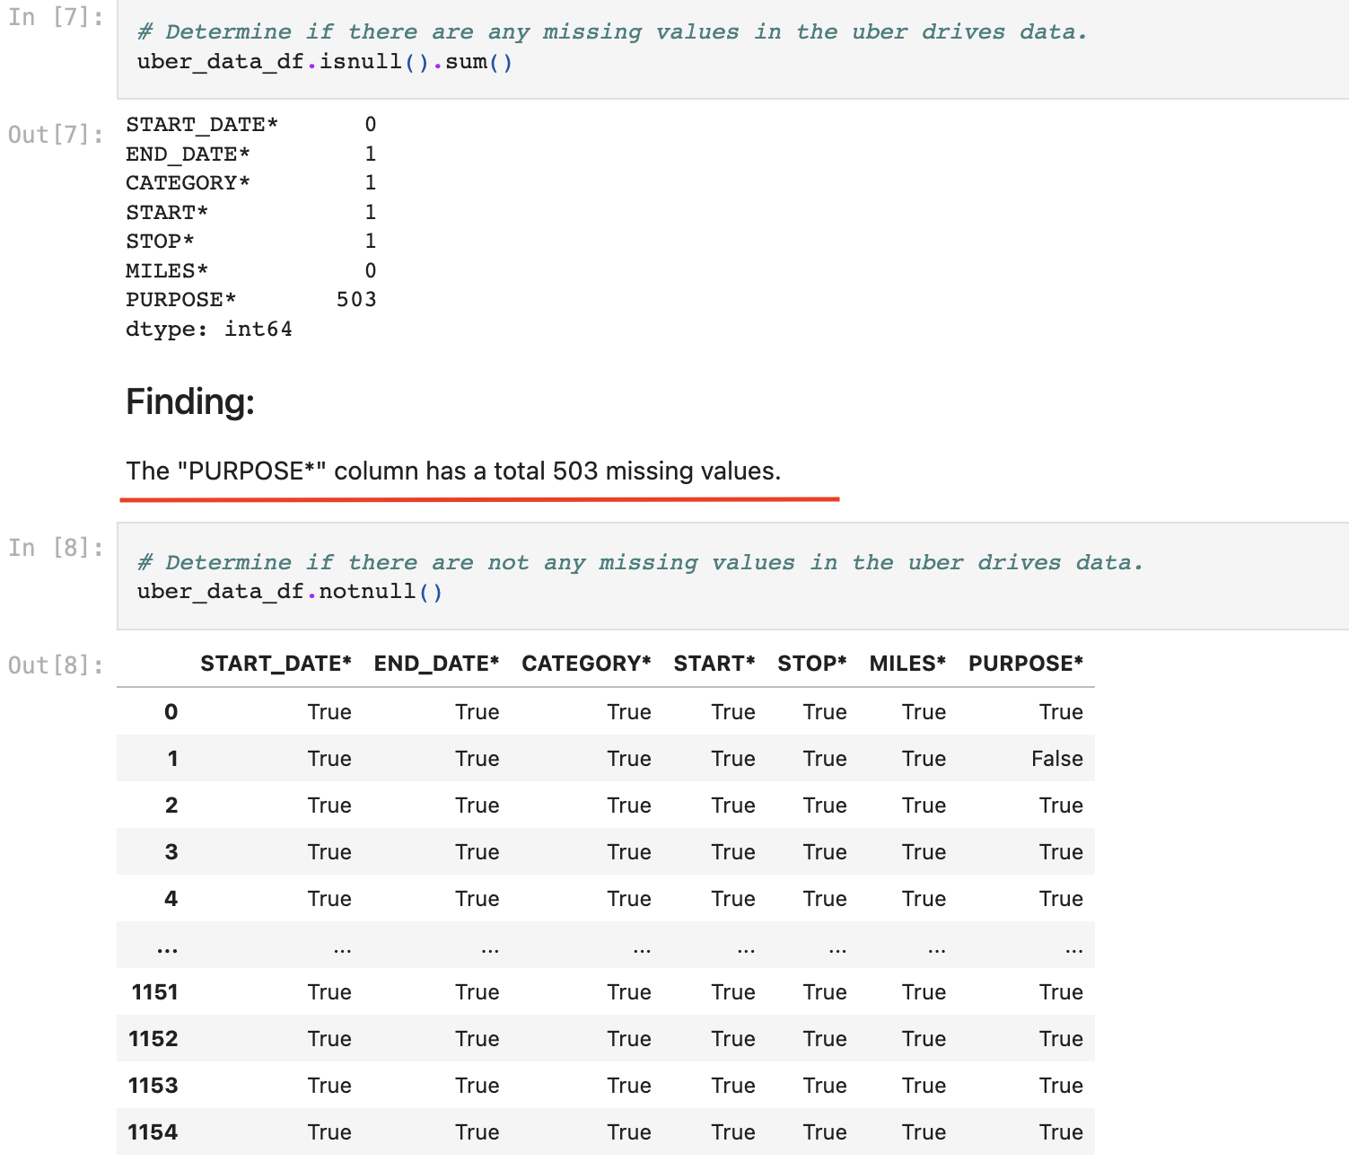

Slide 10
Should we keep -or- drop the rows that contain missing values?

Slide 11

We agreed
to drop the rows.

Slide 12
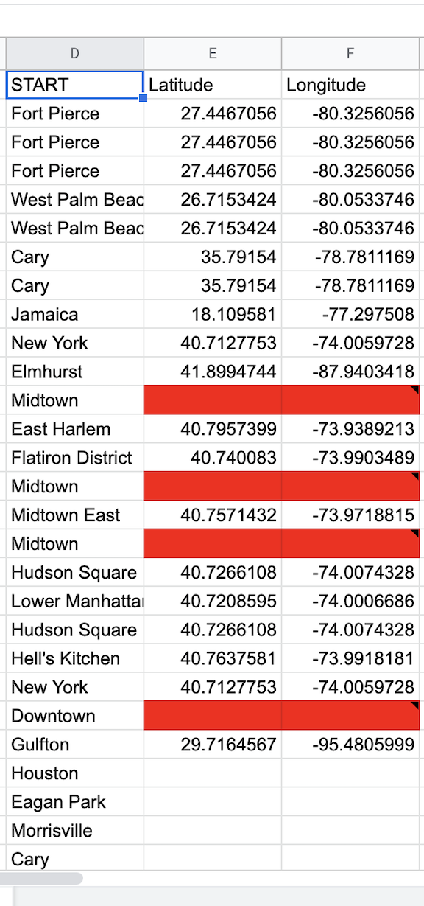
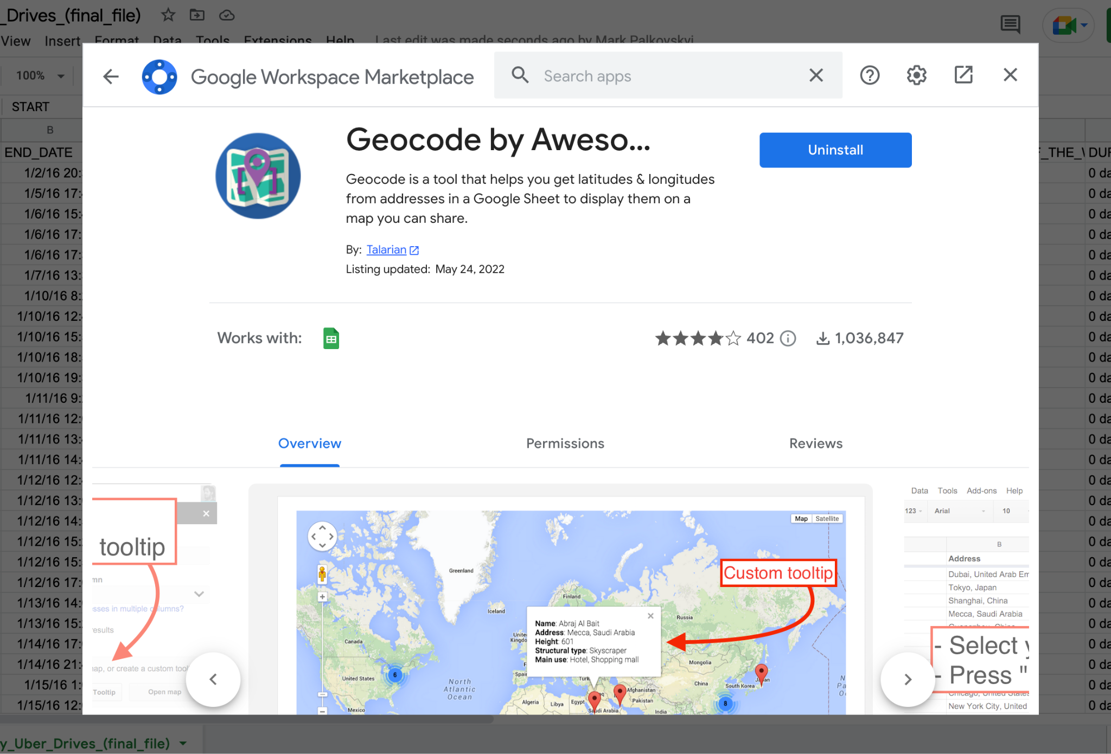
Longitude and Latitude for Start and Stop locations were added with Google Slides extension called "Geocoding with Awesome Table"

Slide 13

Analysis of Data
https://github.com/markpalkovskyi/Final_project/blob/main/My_Uber_Trips_(final_file).ipynb

Slide 14
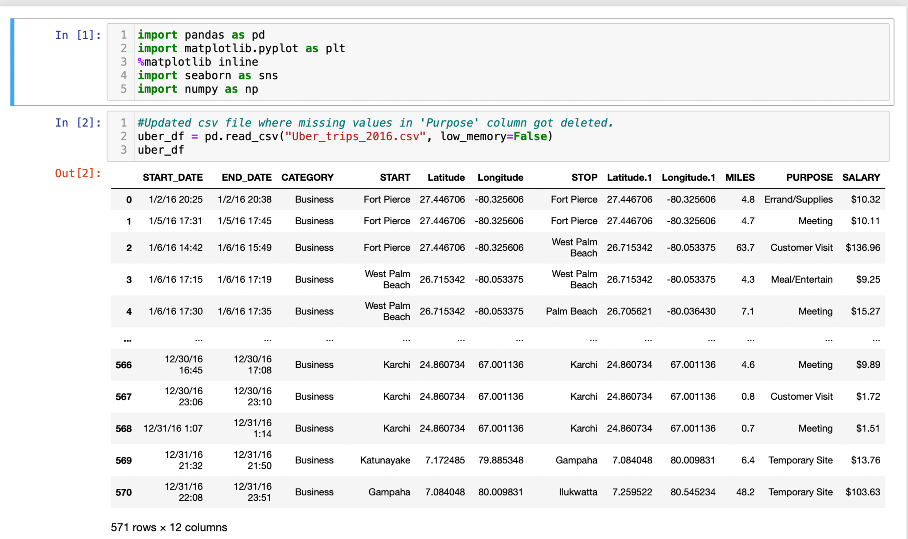

Slide 15
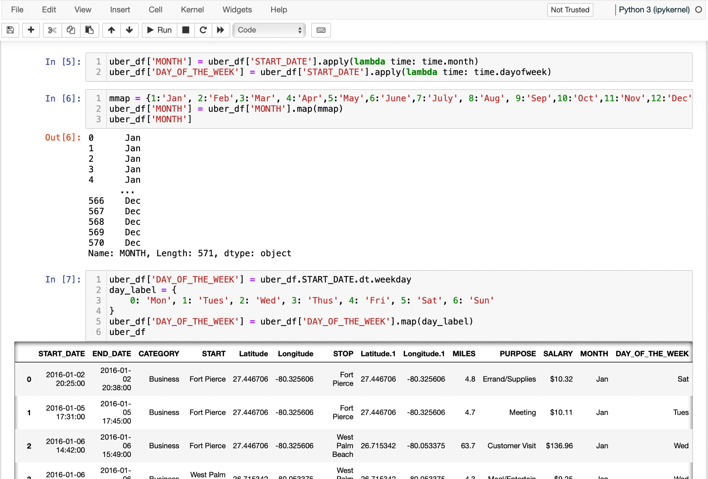
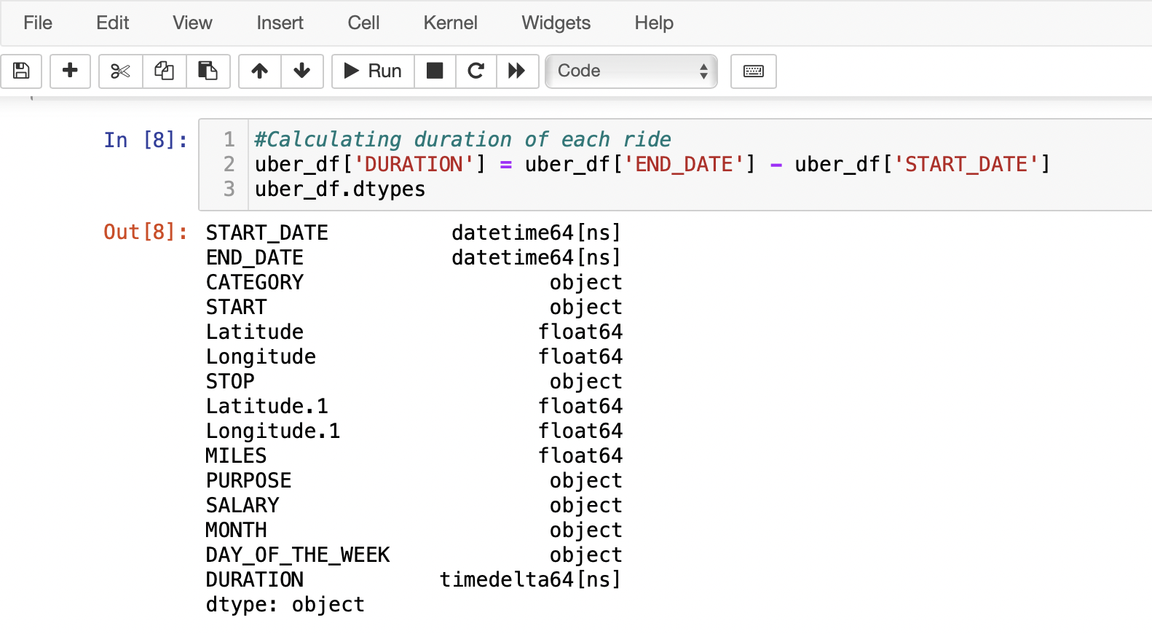
Calculated Duration column by subtracting End_Date from Start_Date
Function to create Month & Day of the week columns
.apply(lambda time: time.month)
.apply(lambda time: time.dayofweek)

Slide 16
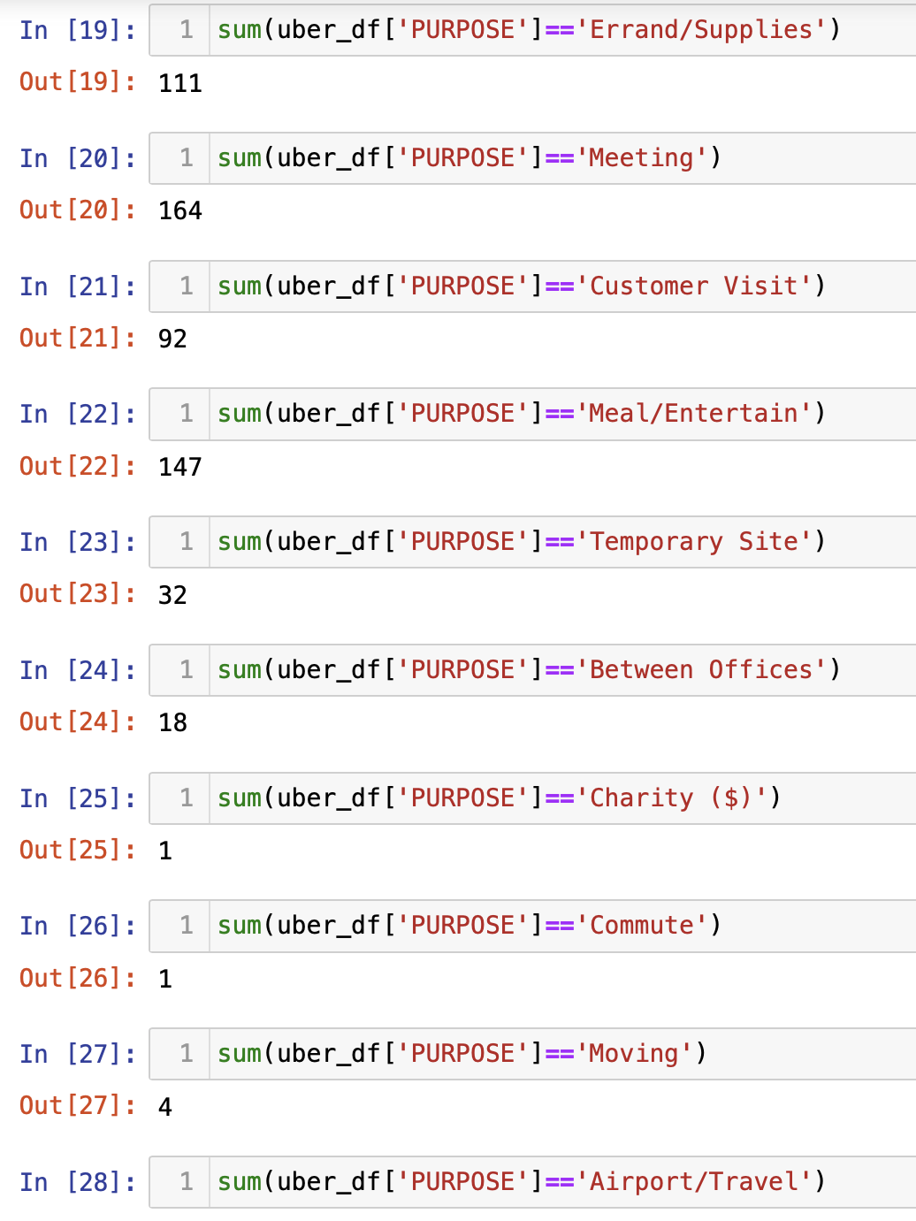
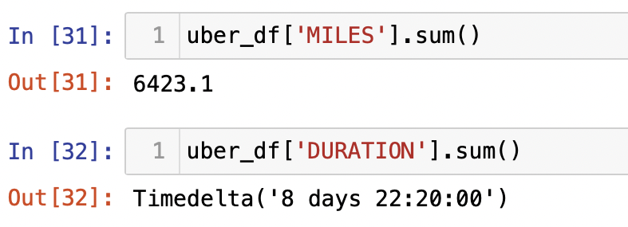
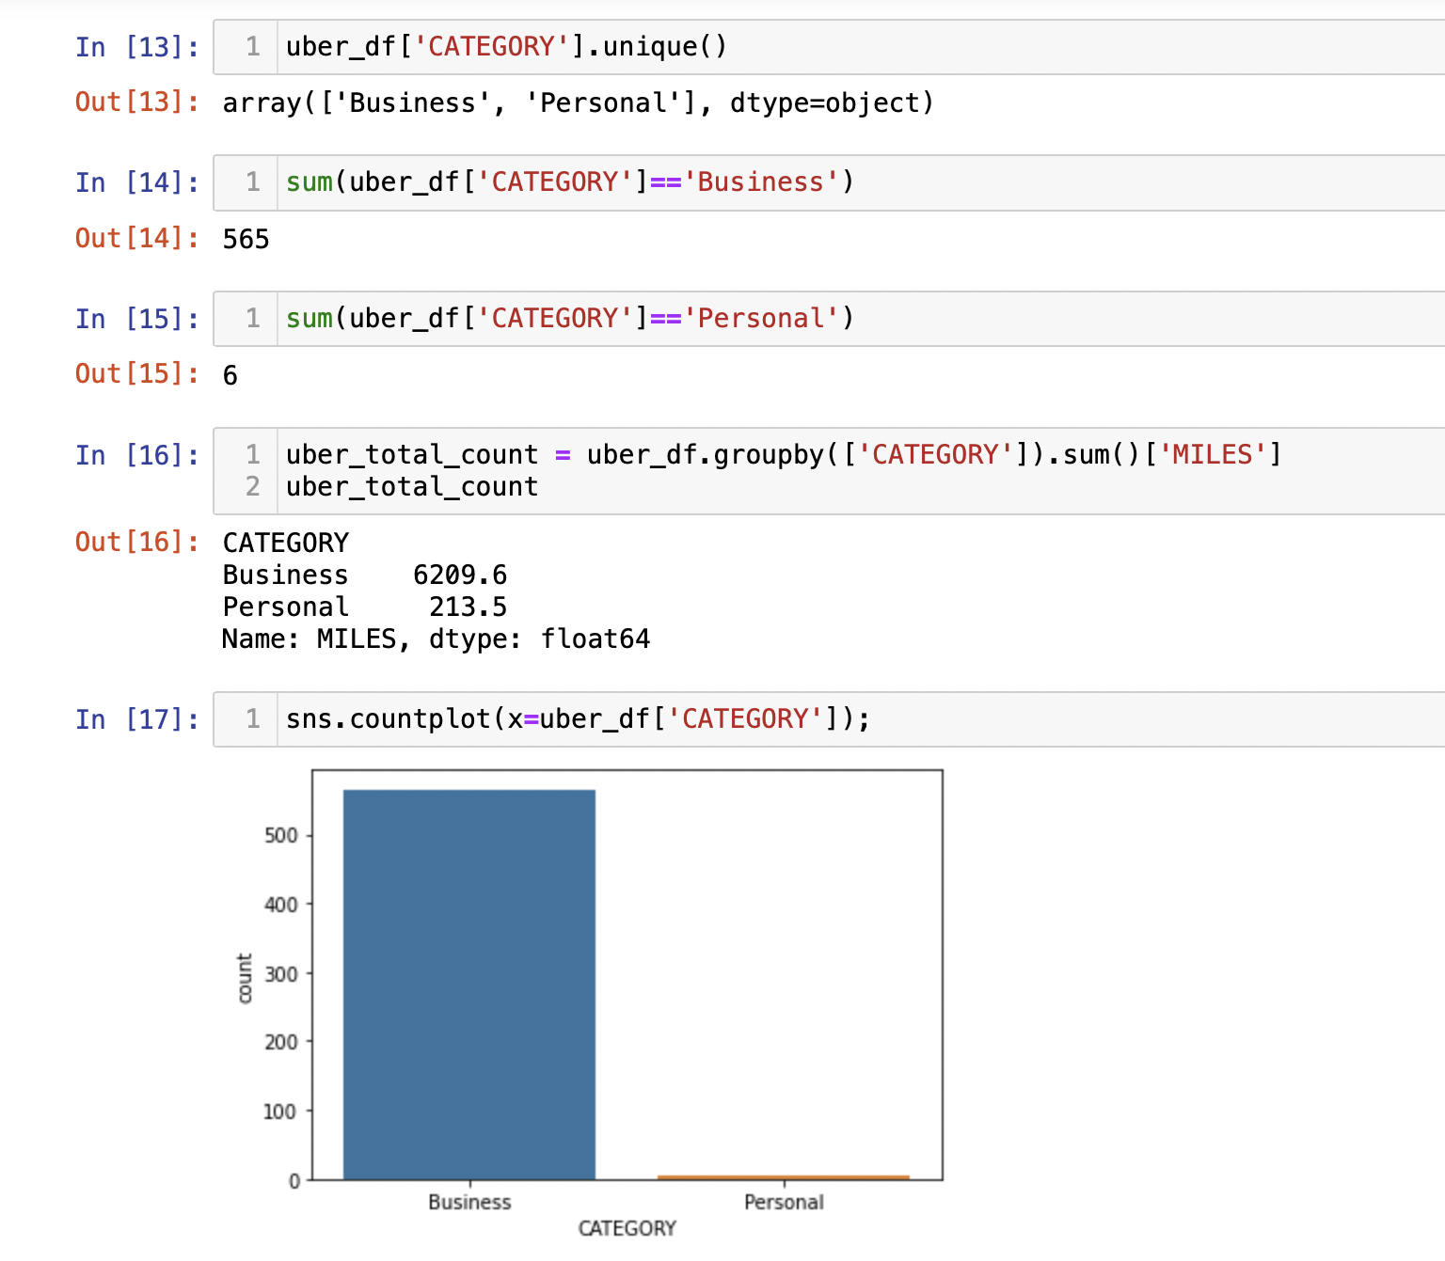

Slide 17
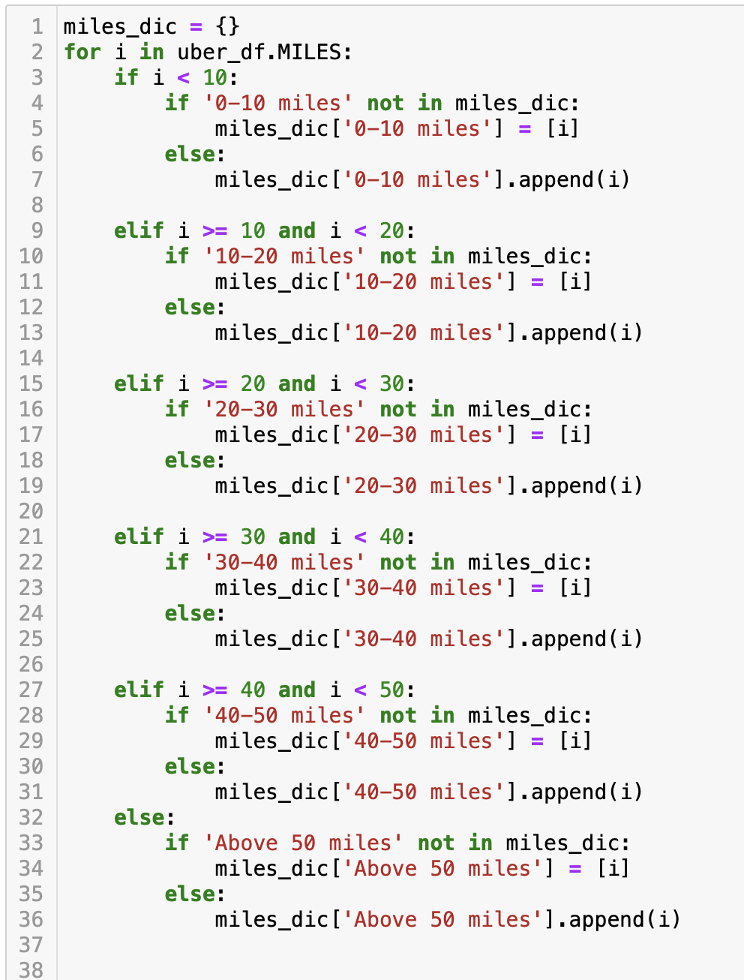
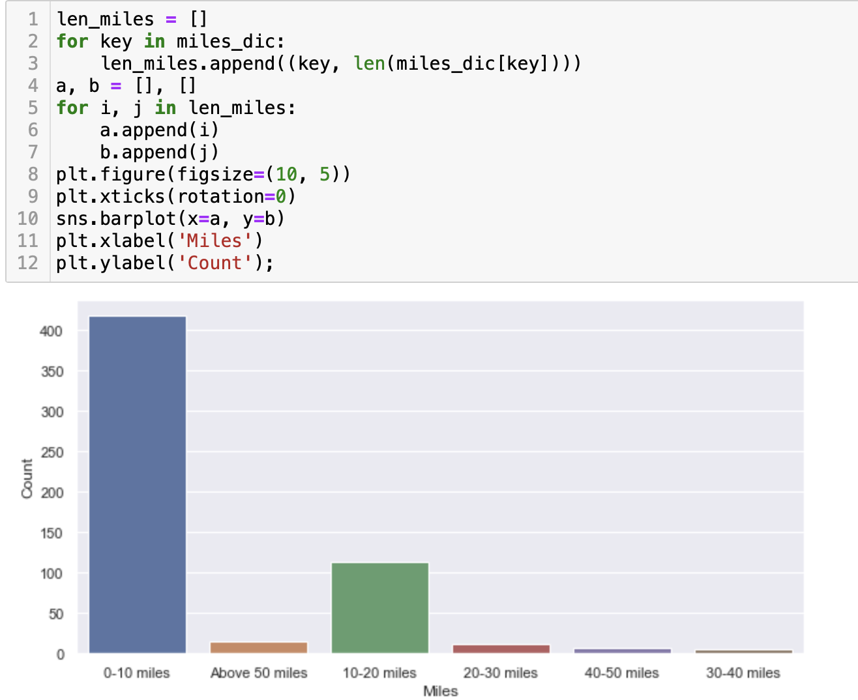

Slide 18
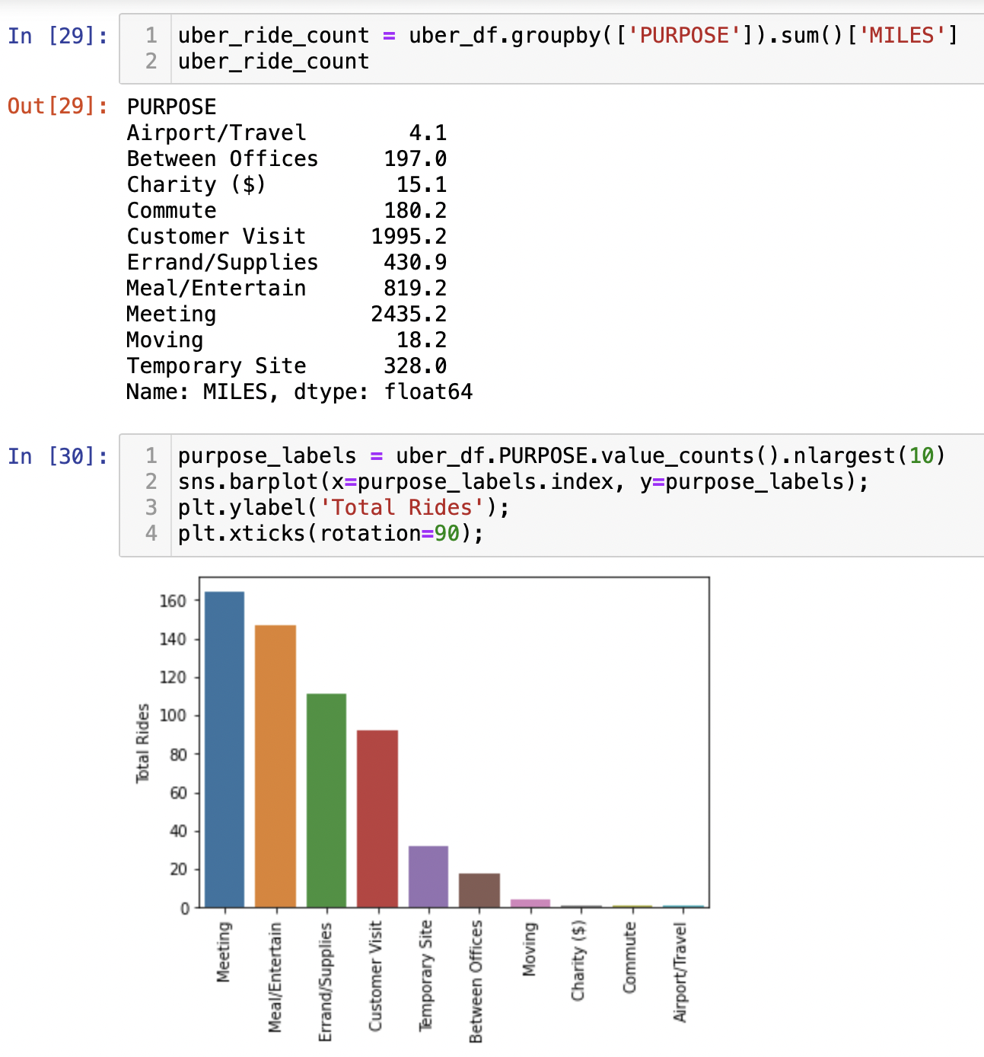

Groupby function were used to find out how many miles the driver drove to certain destination for purposes.
Seaborn barplot calculated a statistic summary for each category.

Slide 19
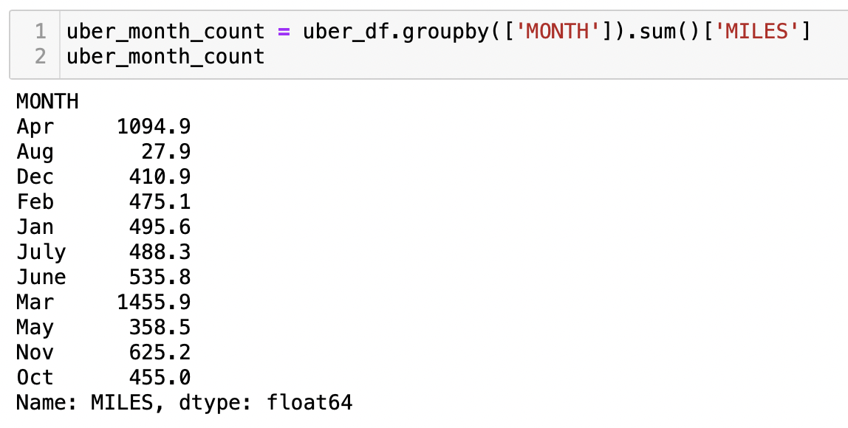
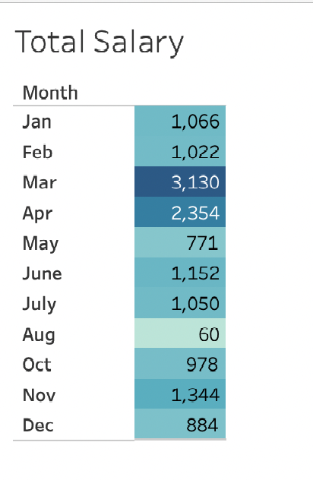
Groupby function to calculate sum of miles for each month + total salary

Slide 20
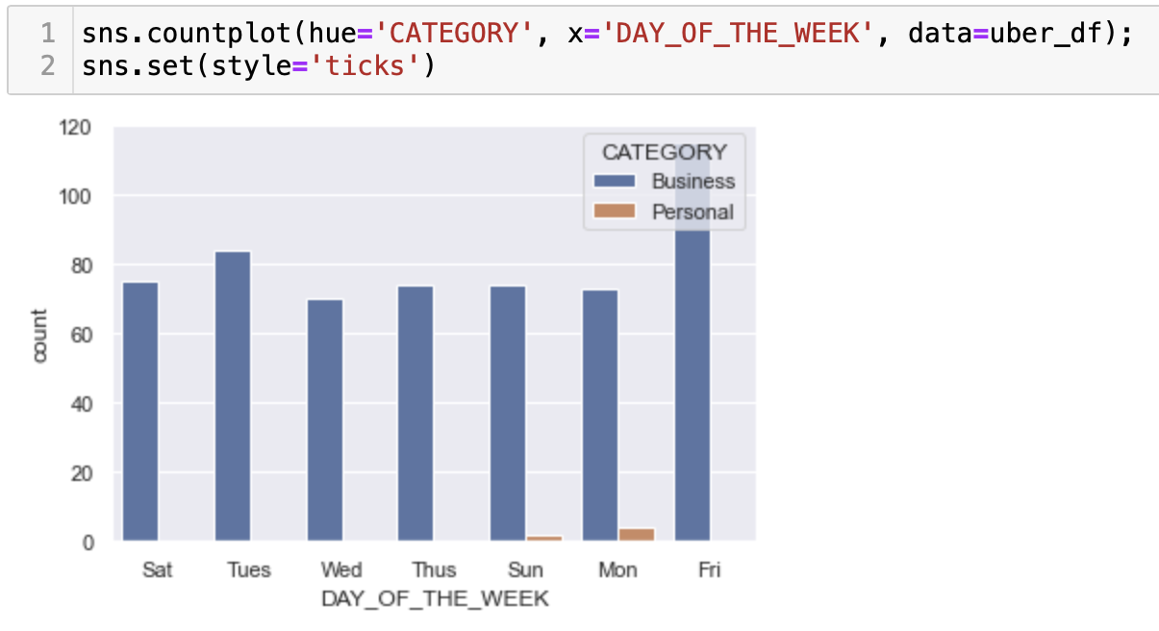
Weekly trips count by category

Slide 21
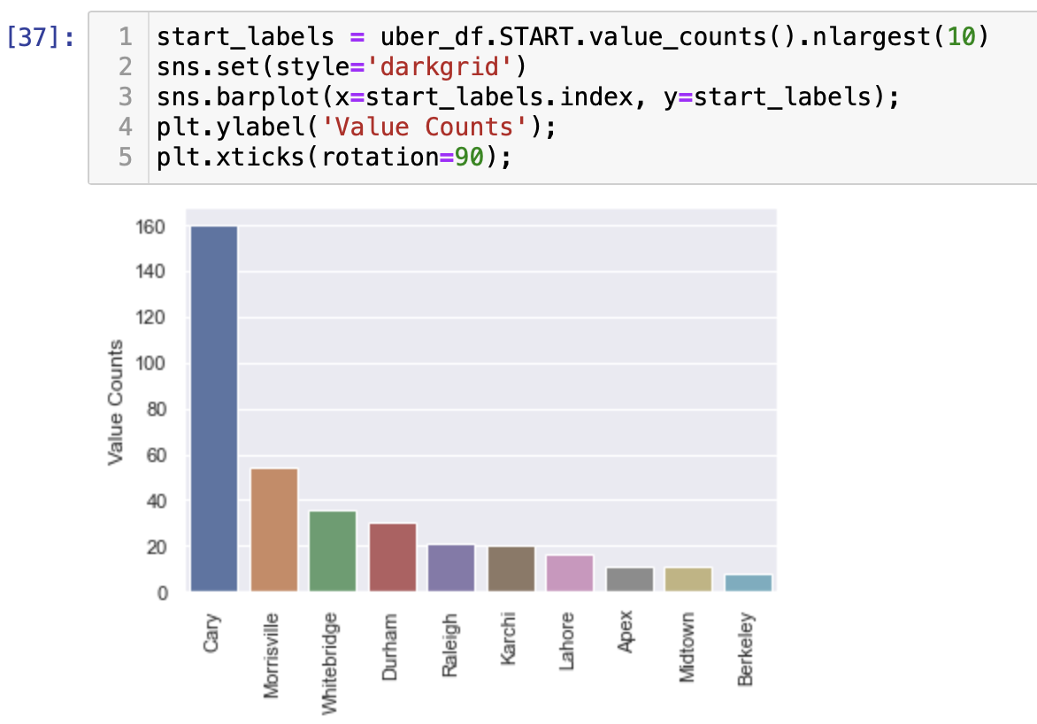
Top 10 most visited cities

Slide 22
Our Database

Slide 23
Amazon Web Services (AWS)
Relational Database Service (RDS)
PostgreSQL (PgAdmin)

Slide 24
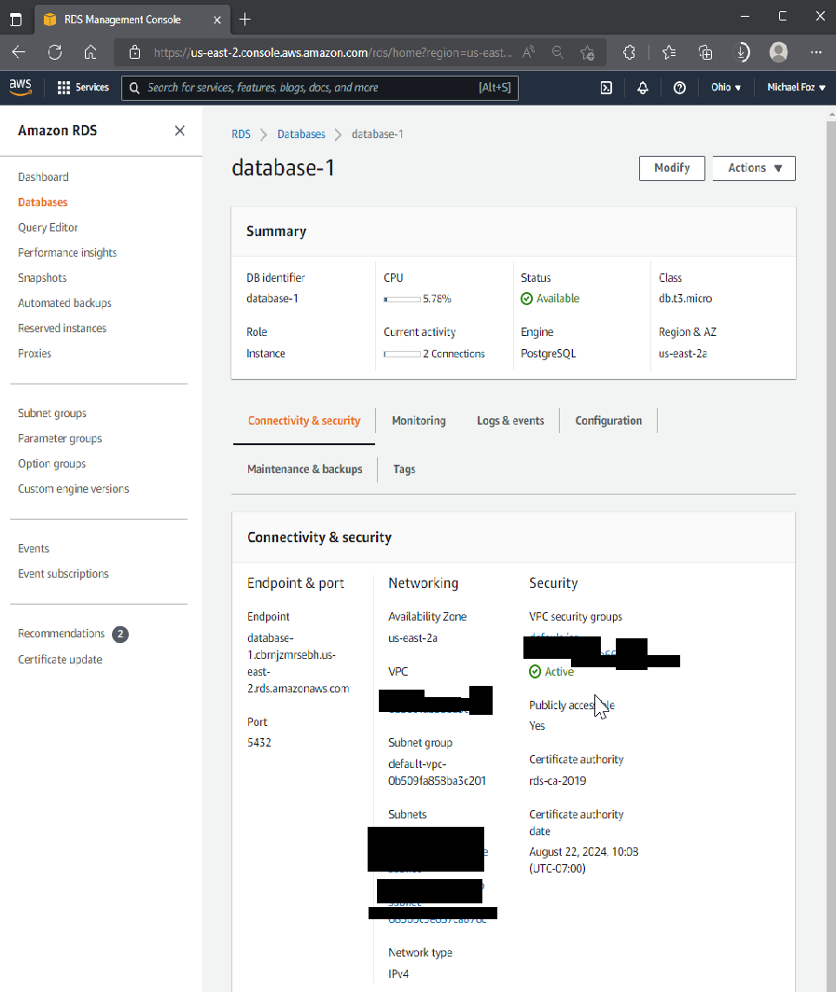

Slide 25
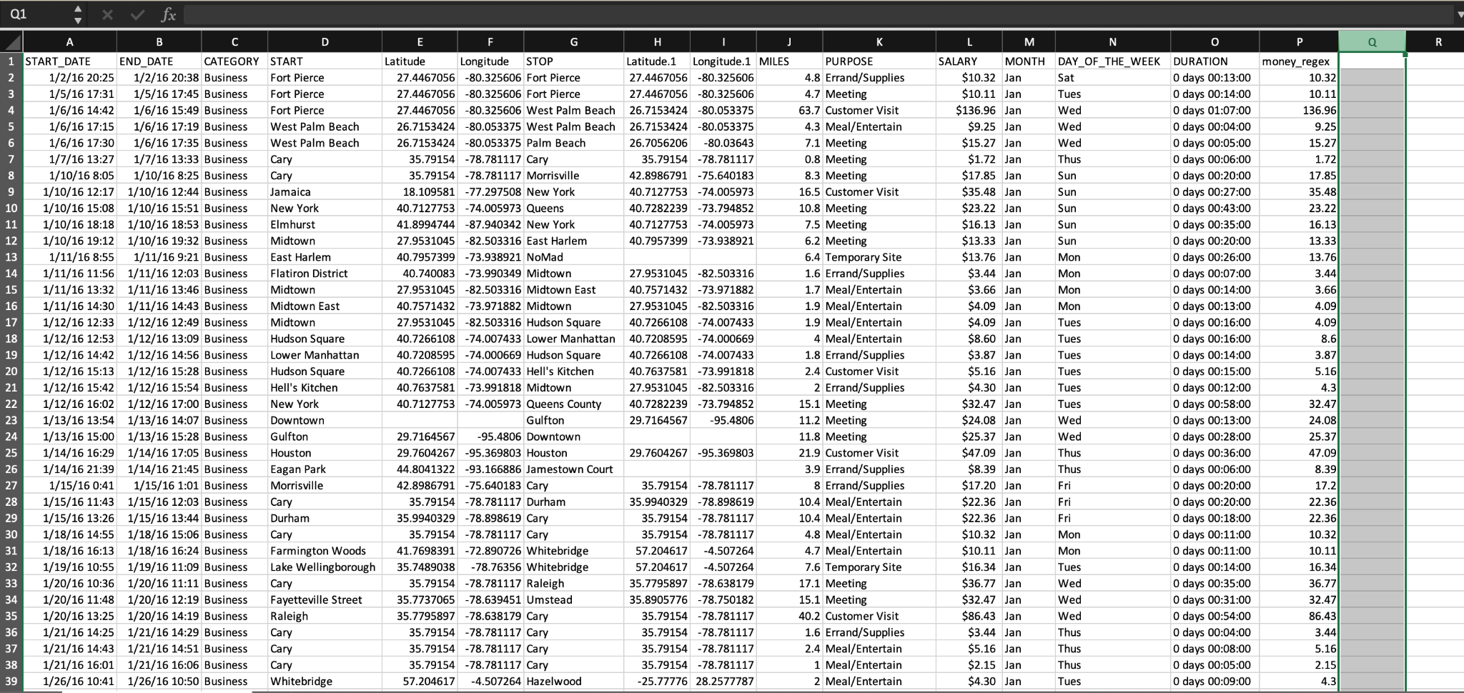
Final file

Slide 26
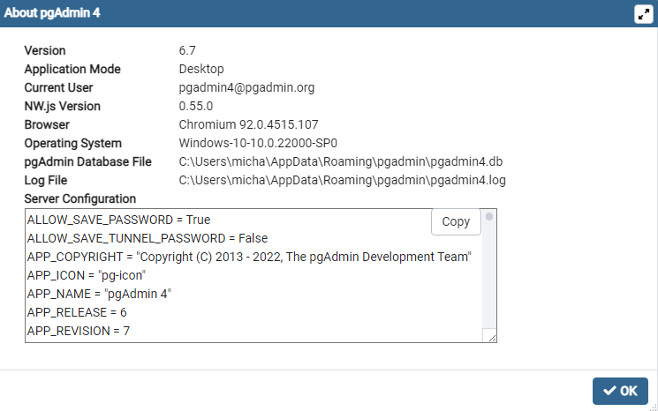

Slide 27
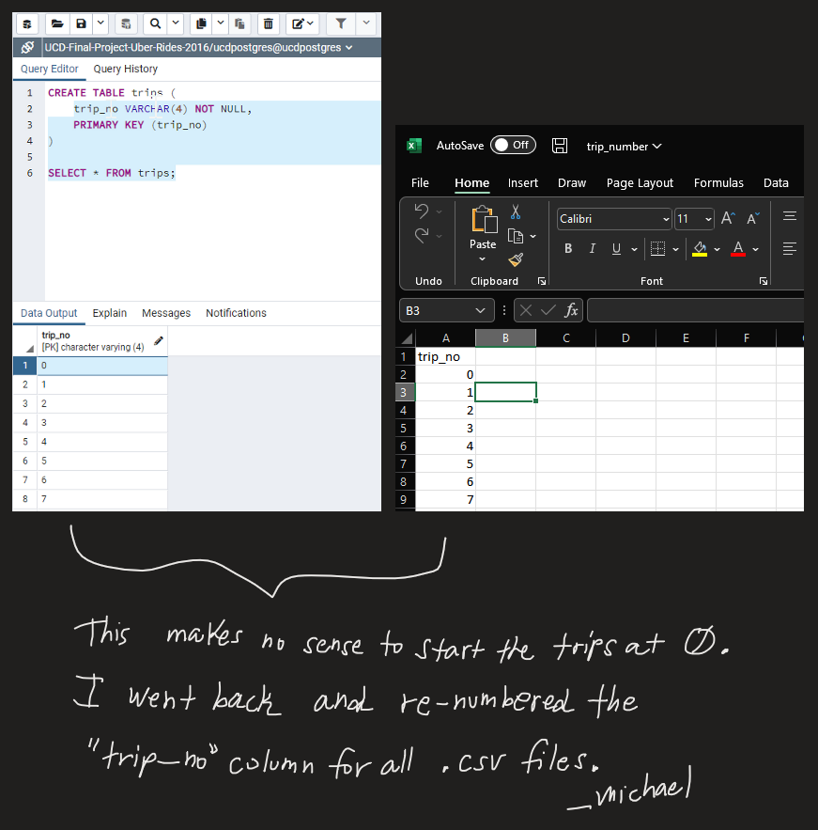

Slide 28
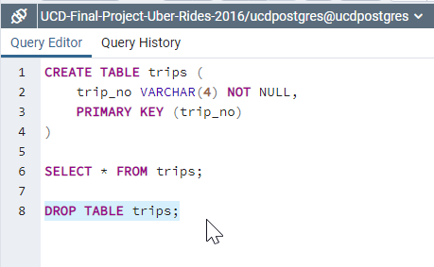

Slide 29
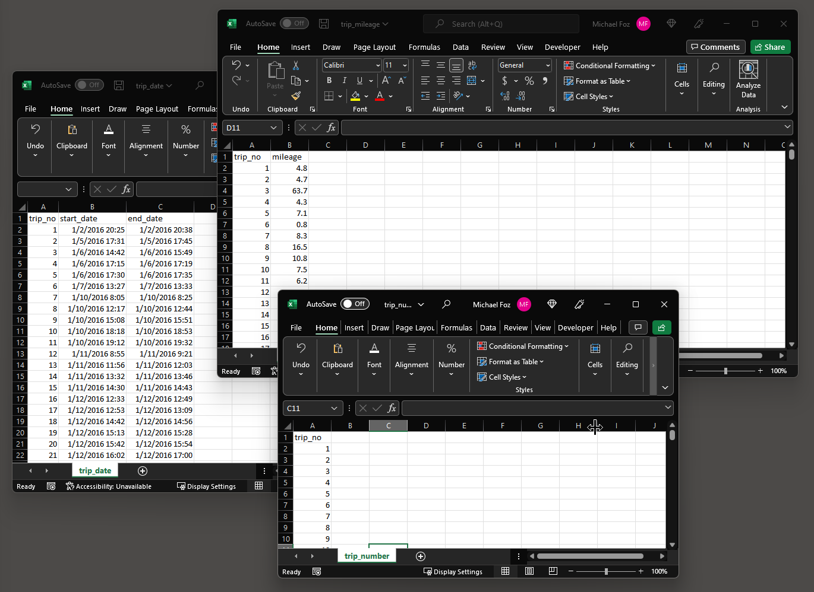

Slide 30
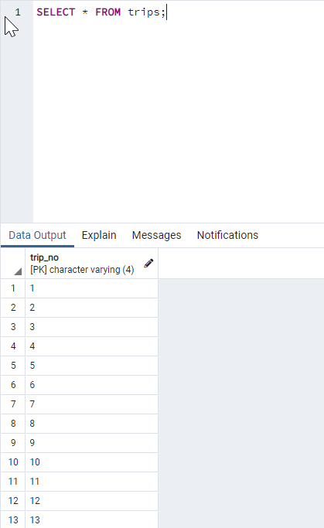

Slide 31
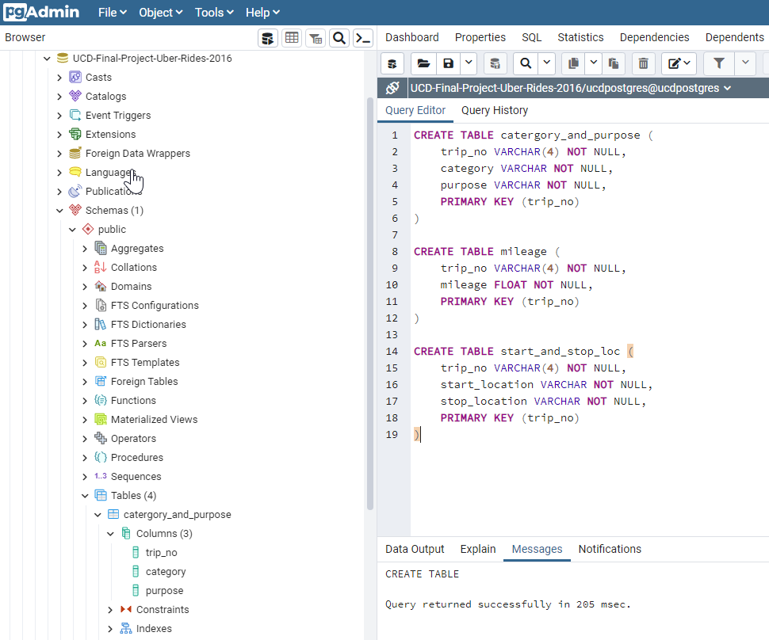

Slide 32
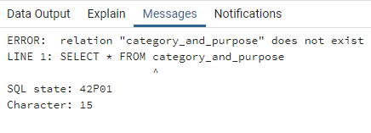

Slide 33

“catergory_and_purpose”

Slide 34
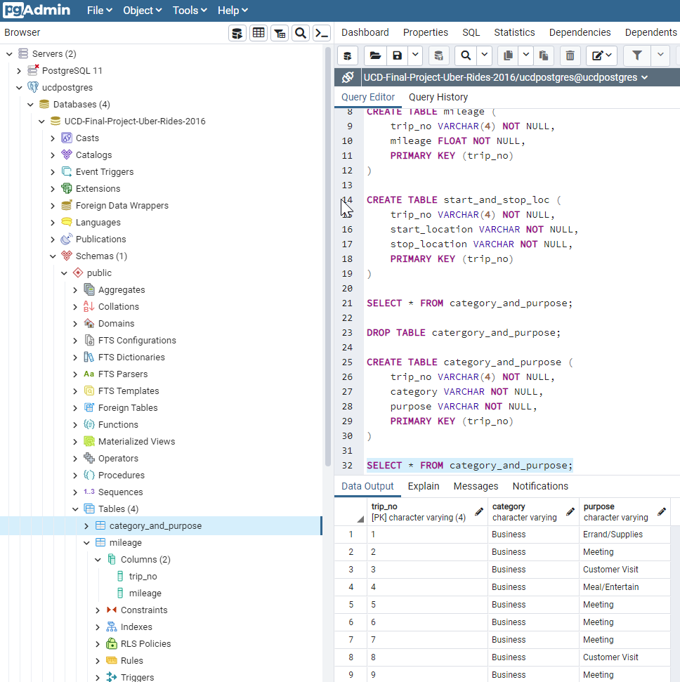

Slide 35
Leaflet Map
https://michaelfoz.github.io/ucd-bootcamp-final-project-leaflet/

Slide 36
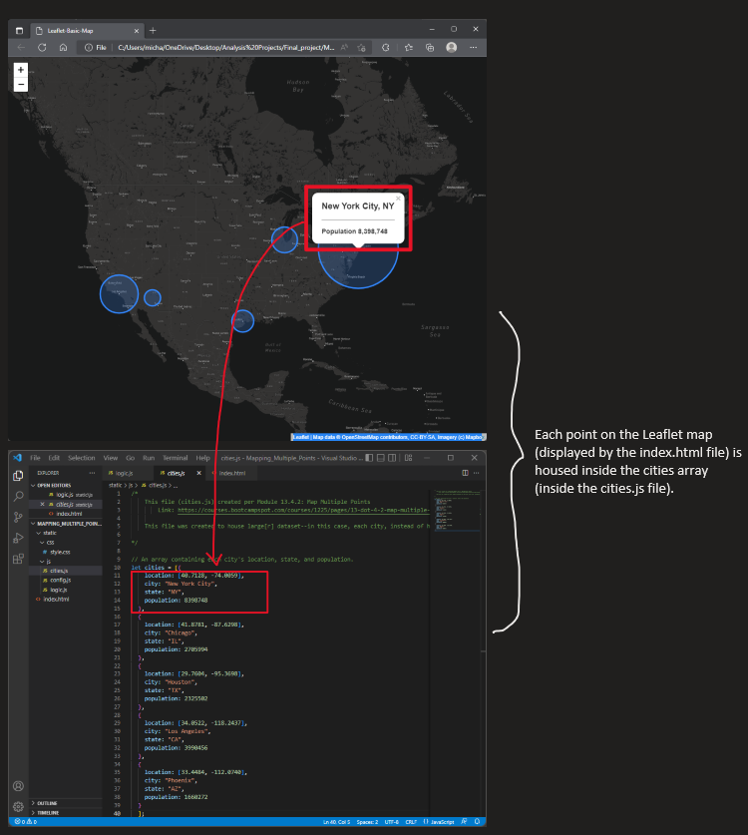

Slide 37
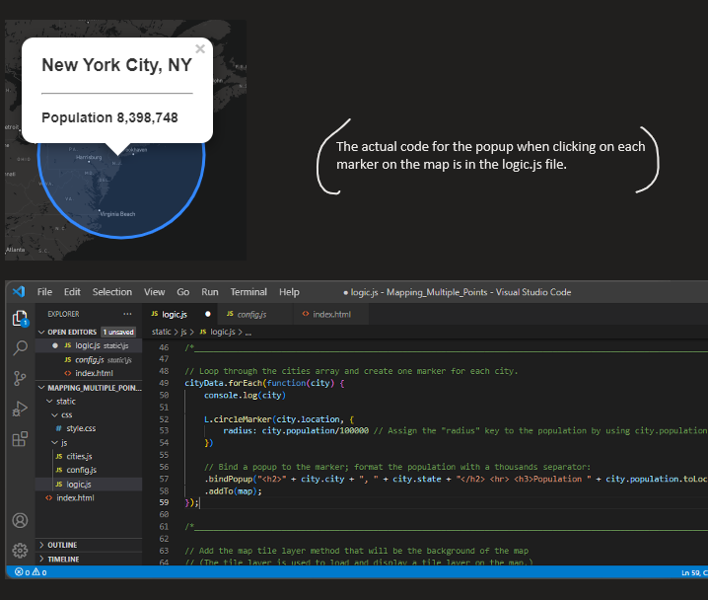

Slide 38
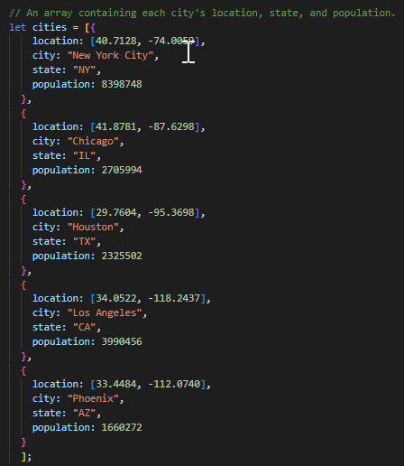
Syntax:
An array–within it:
the coordinates
[latitude, longitude]

Slide 39
How does one convert all of the locations in the original file to follow the [latitude, longitude]?

Slide 40


Slide 41
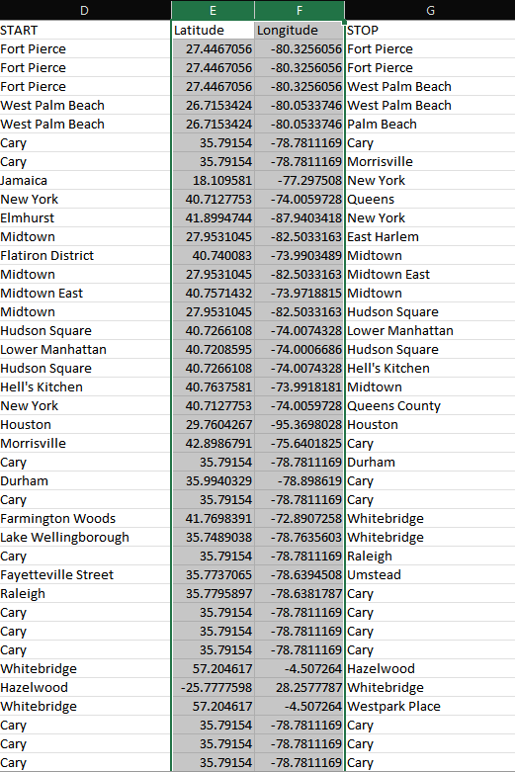

Slide 42
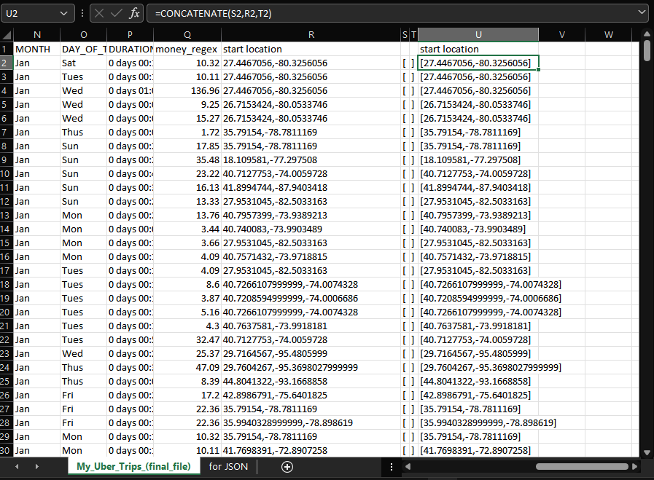

Slide 43
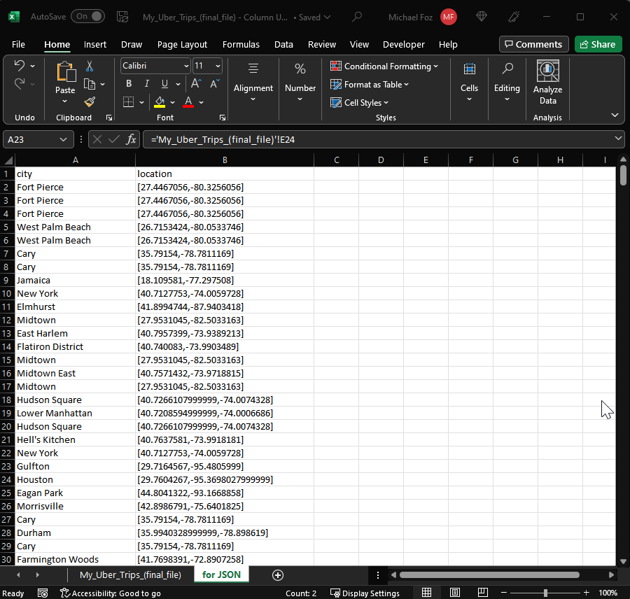

Slide 44
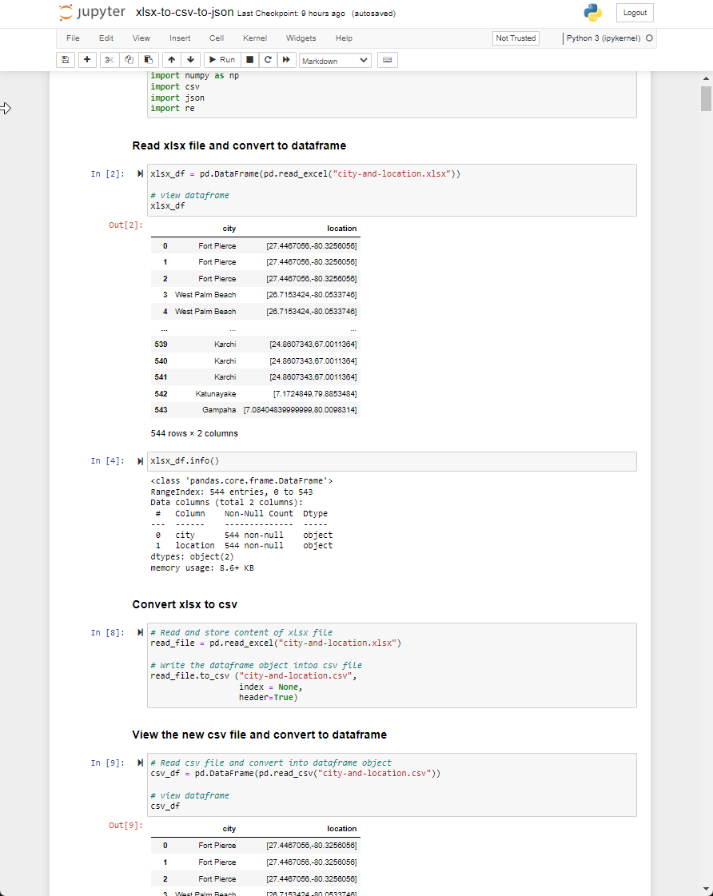

Slide 45
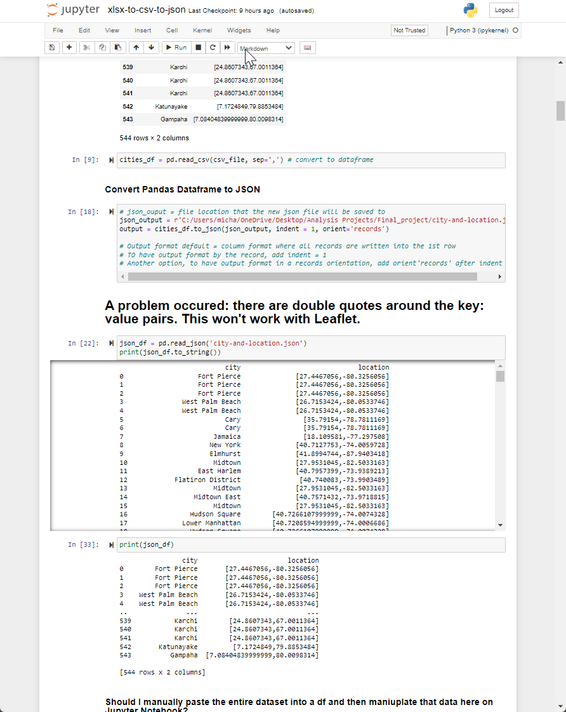

Slide 46
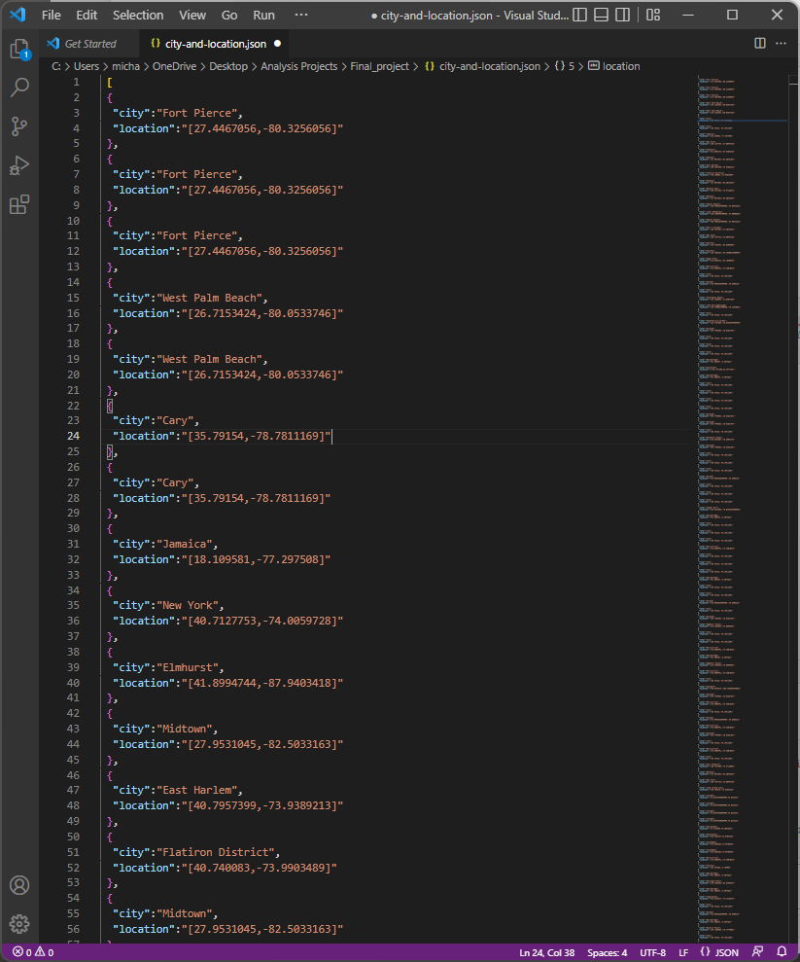

Slide 47
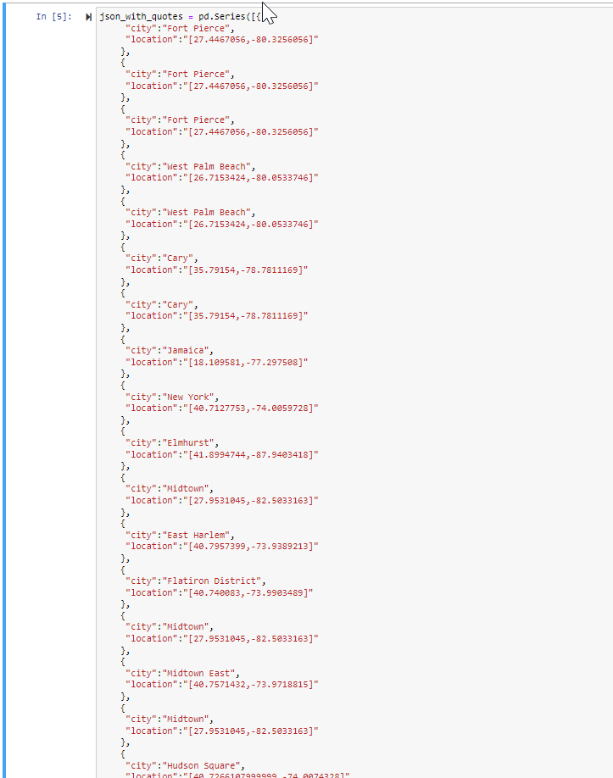
Should I convert the ENTIRE dataframe into a string? ☠️

Slide 49
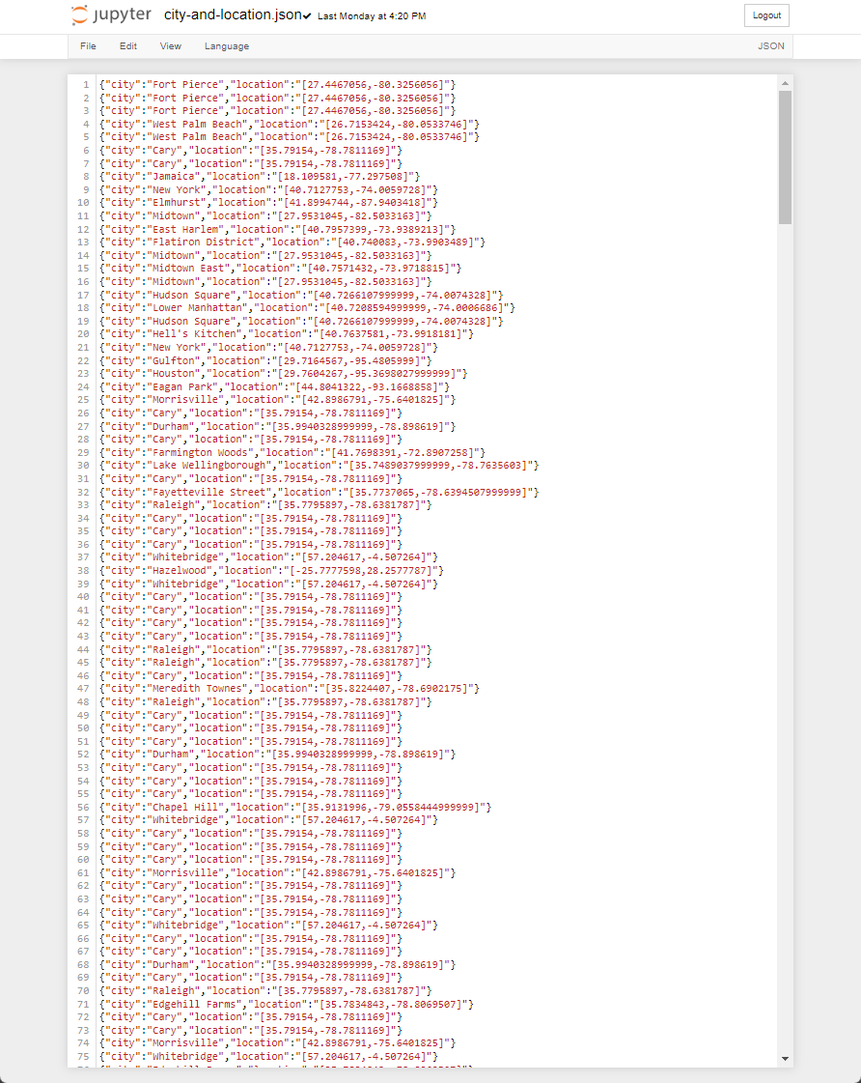

Slide 50
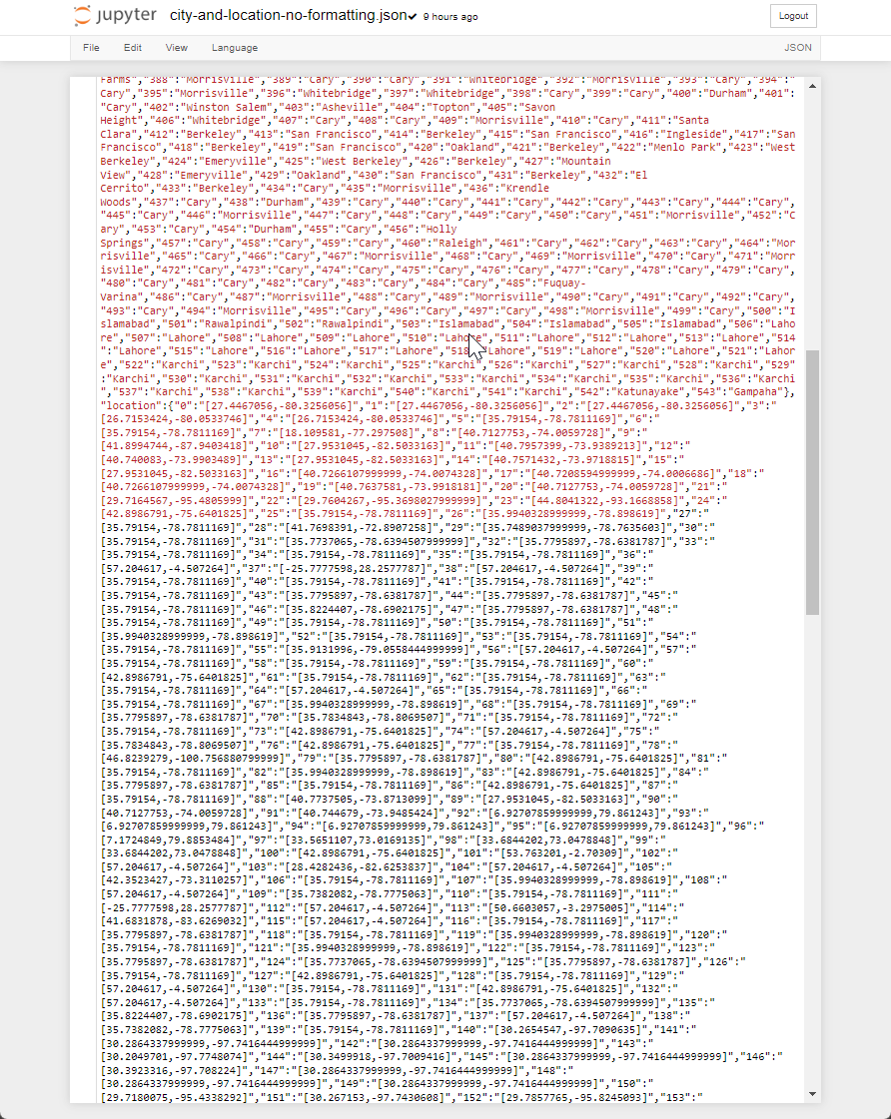

Slide 51
Leaflet Map
https://michaelfoz.github.io/ucd-bootcamp-final-project-leaflet/

Slide 52
Machine Learning
Logistic regression - predicts binary outcomes Q:“Less trips were made on Mondays.”
A: (Yes/No)

Slide 53

https://public.tableau.com/app/profile/mark3073/viz/Uber_Ride_2016/Dashboard2

Slide 54
Why should you take a data analyst with you into the jungle?

Slide 55


Answer: They can take care of Python problems.

